Slide 1
Global Infant Mortality Rate & Fertility Rate
Dats 6103 individual project ii
Presenter: Xinyu (mandy) Zhang
Professor: Nima zahadat
Notes:
Hello everyone, welcome to my second individual project. Today I’m going to talk about global infant mortality rate and the correlation with fertility rate.

Slide 2
Introduction
What: Infant mortality rate and fertility rate in 173 countries
When: From 2011 to 2015; 5 years
How:
The distribution of infant mortality rate
How does infant mortality change in countries or in regions in 5 years?
What’s the percent of change of infant mortality in each country over the past 5 years?
How does fertility rate change in countries or in regions in 5 years?
What’s the connection between fertility rate and infant mortality rate?
What will happen about the infant mortality and fertility rate in the future?
Notes:
The question about birth to death never end in human history. For me personally, I was born in one child policy that each family can only have one child; for my parents, they were born in a “Hero Mother” policy, which means that the government encouraged women to have more children. The more, the better. I can’t say which policy is better. But as far as I know, now I have my parents’ full love and I have so many opportunities to accomplish myself; However in my parents’ generation, they don’t have such resources. Why? Perhaps this is because they have many siblings and thus they can’t have as much as I do. In their generation, it was very common that their siblings died in a very young age. So I want to investigate the relationship with the infant mortality and fertility rate globally.

Slide 3
Data Information I: Infant Mortality Rate
Source: the World Bank national data, estimates developed by the UN Inter-agency Group for Child Mortality Estimation.
Website: https://data.worldbank.org/indicator/SP.DYN.IMRT.IN?view=chart
Infant mortality rate: the number of infants dying before reaching one year of age, per 1,000 live births in a given year.
Periodicity: Annual
Year: 1960 – 2016
193 countries with 7 region areas

Slide 4
Data Information II: Fertility Rate
Source: the World Bank national data.
United Nations Population Division. World Population Prospects
Census reports and other statistical publications from national statistical offices
Eurostat: Demographic Statistics
United Nations Statistical Division. Population and Vita
Website: https://data.worldbank.org/indicator/SP.DYN.TFRT.IN/
Fertility rate: the number of children that would be born to a woman if she were to live to the end of her childbearing years and bear children in accordance with age-specific fertility rates of the specified year.
Periodicity: Annual
Year: 1960 – 2016
193 countries with 7 region areas

Slide 5
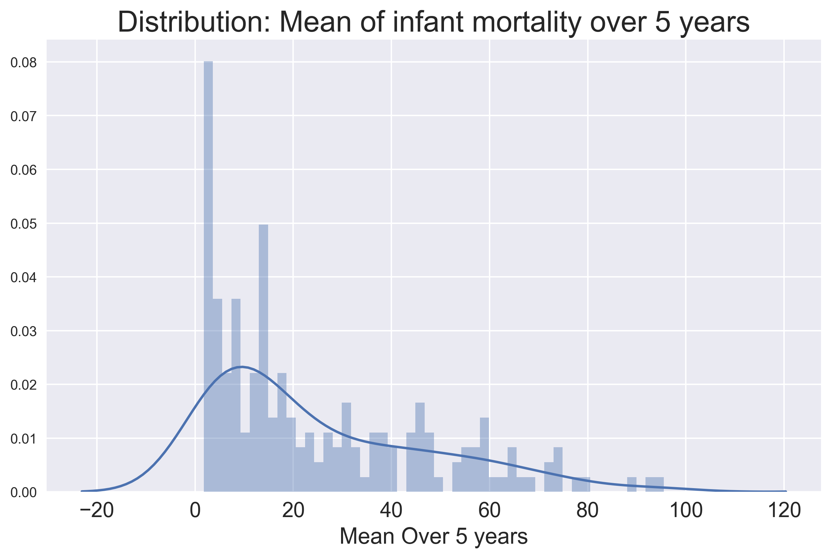
Overview in Infant Mortality
Year: 2011-2015
Remove countries which have missing data in the period
Add a new column which each row (country) is the mean value of 5 years

Slide 6
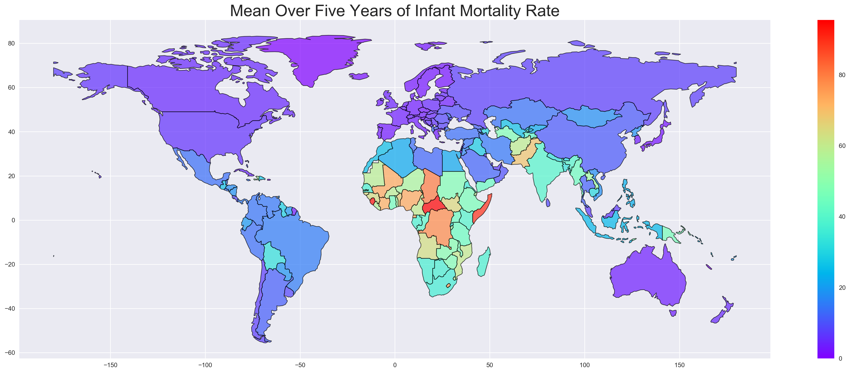
Notes:
Sub-Saharan Africa is the region with the highest level of child mortality

Slide 7
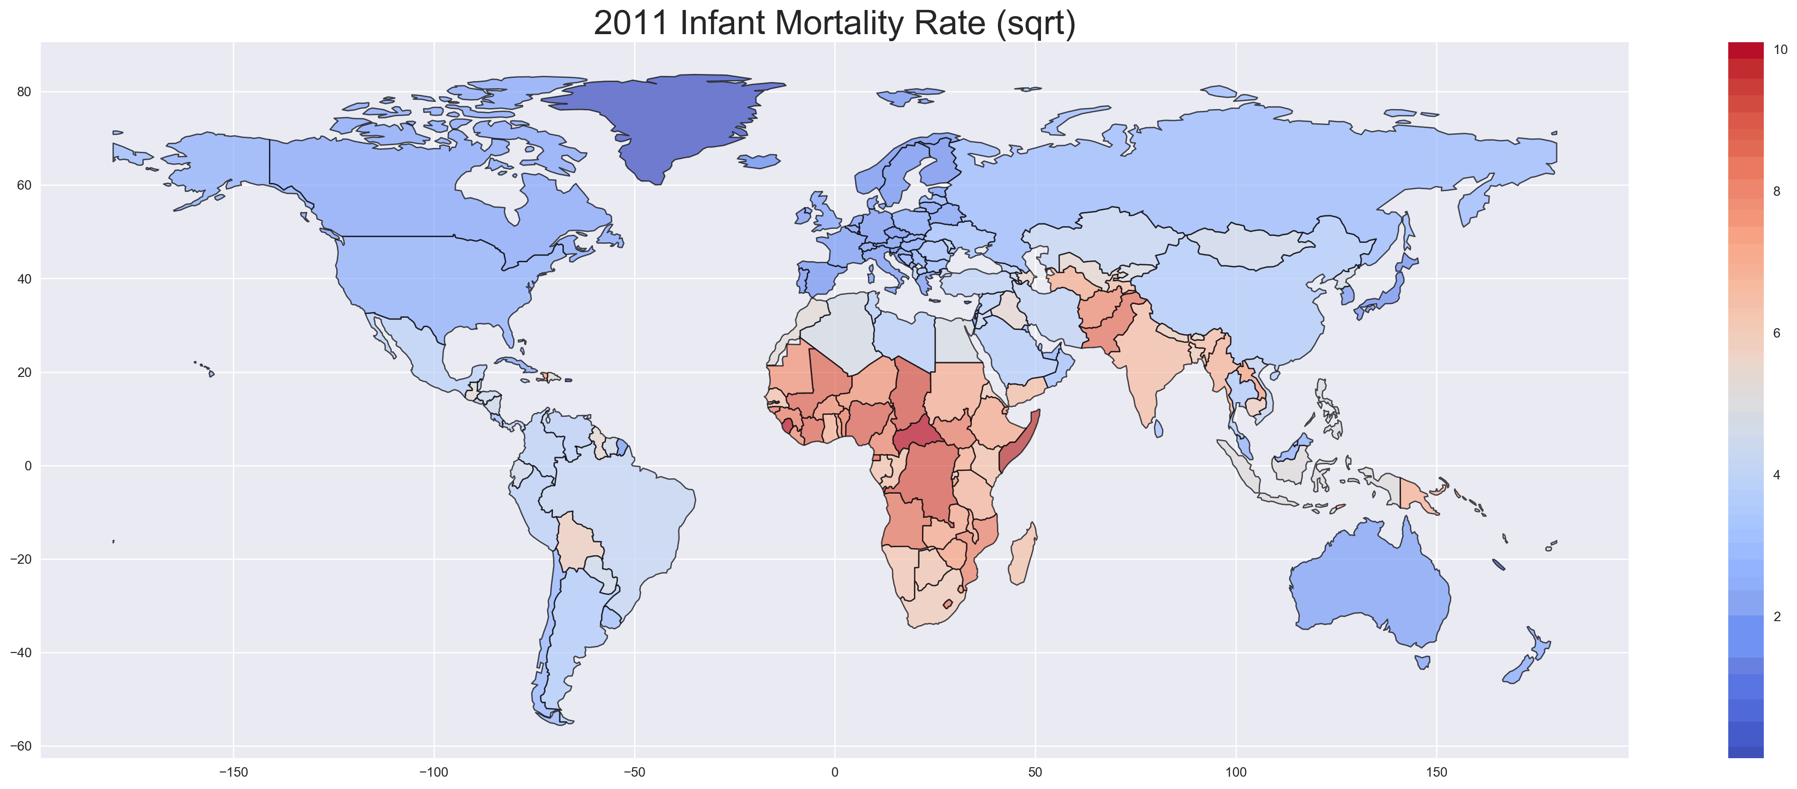
Notes:
Sub-Saharan Africa is the region with the highest level of child mortality
Infant mortality has declined in all regions all over the world.

Slide 8
Overview in Infant Mortality
Region | Numb of Countries
East Asia & Pacific | 30
Europe & Central Asia | 51
Latin America & Caribbean | 33
Middle East & North Africa | 21
North America | 2
South Asia | 8
Sub-Saharan Africa | 48
Year: 2011-2015
Remove countries which have missing data in the period
Add a new column which each row (country) is the mean value of 5 years

Slide 9
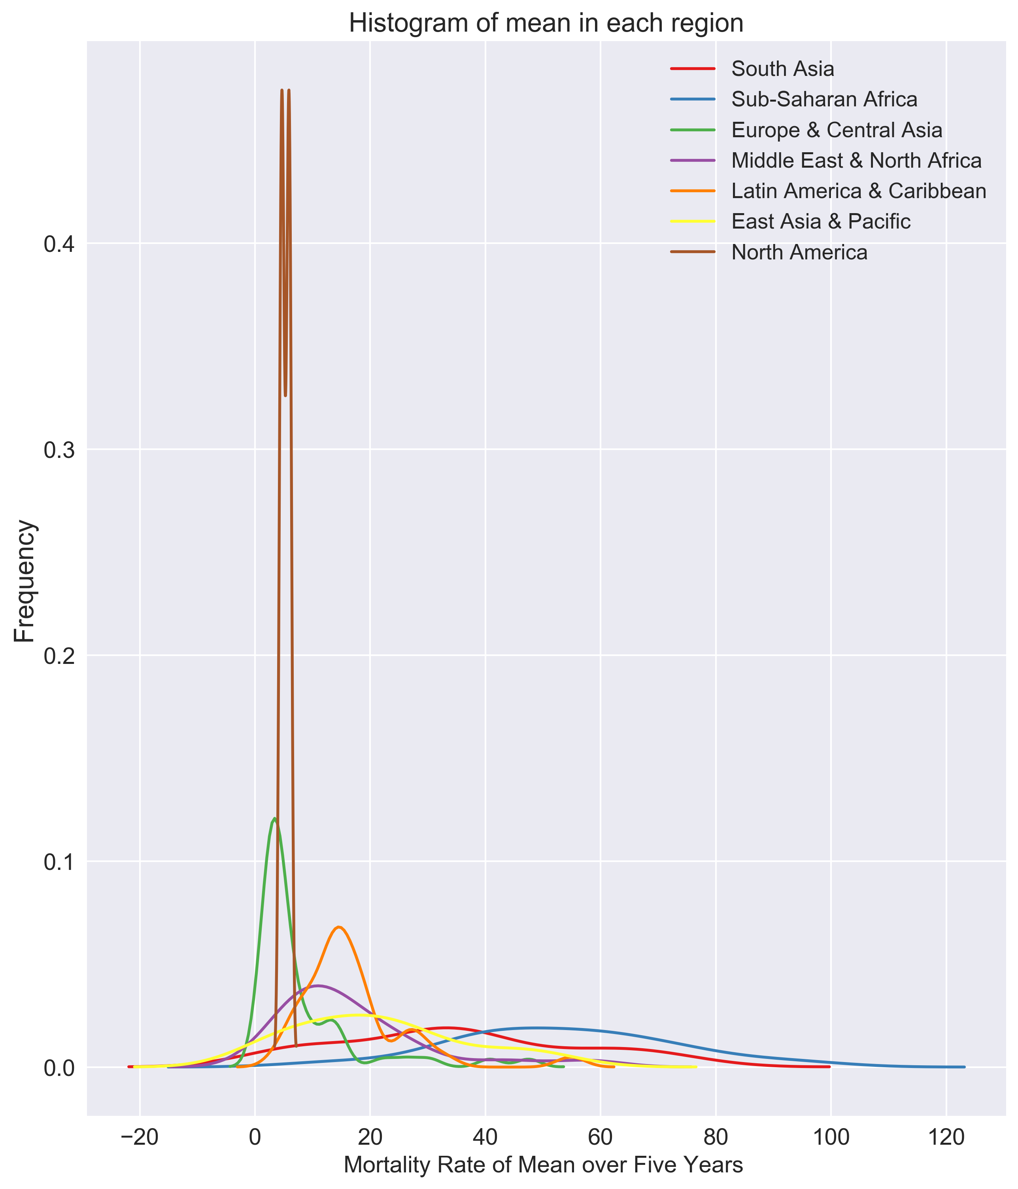
Overview in Infant Mortality
Year: 2011-2015
Remove countries which have missing data in the period
Add a new column which each row (country) is the mean value of 5 years
Notes:
Since we only have two data points in North America region, we can remove the corresponding brown line and have a better vision of other regions distributions.

Slide 10
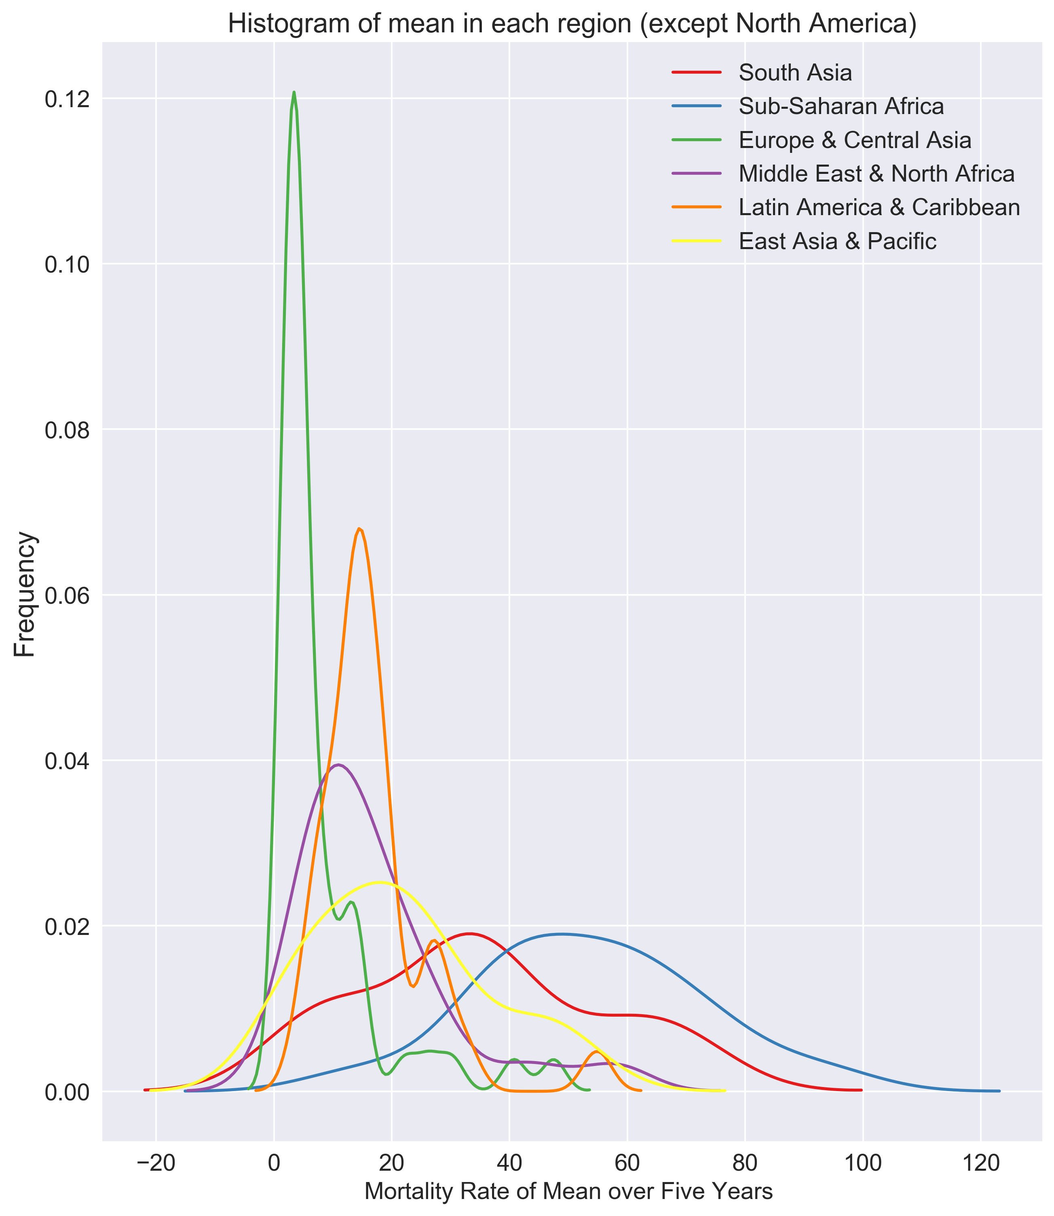
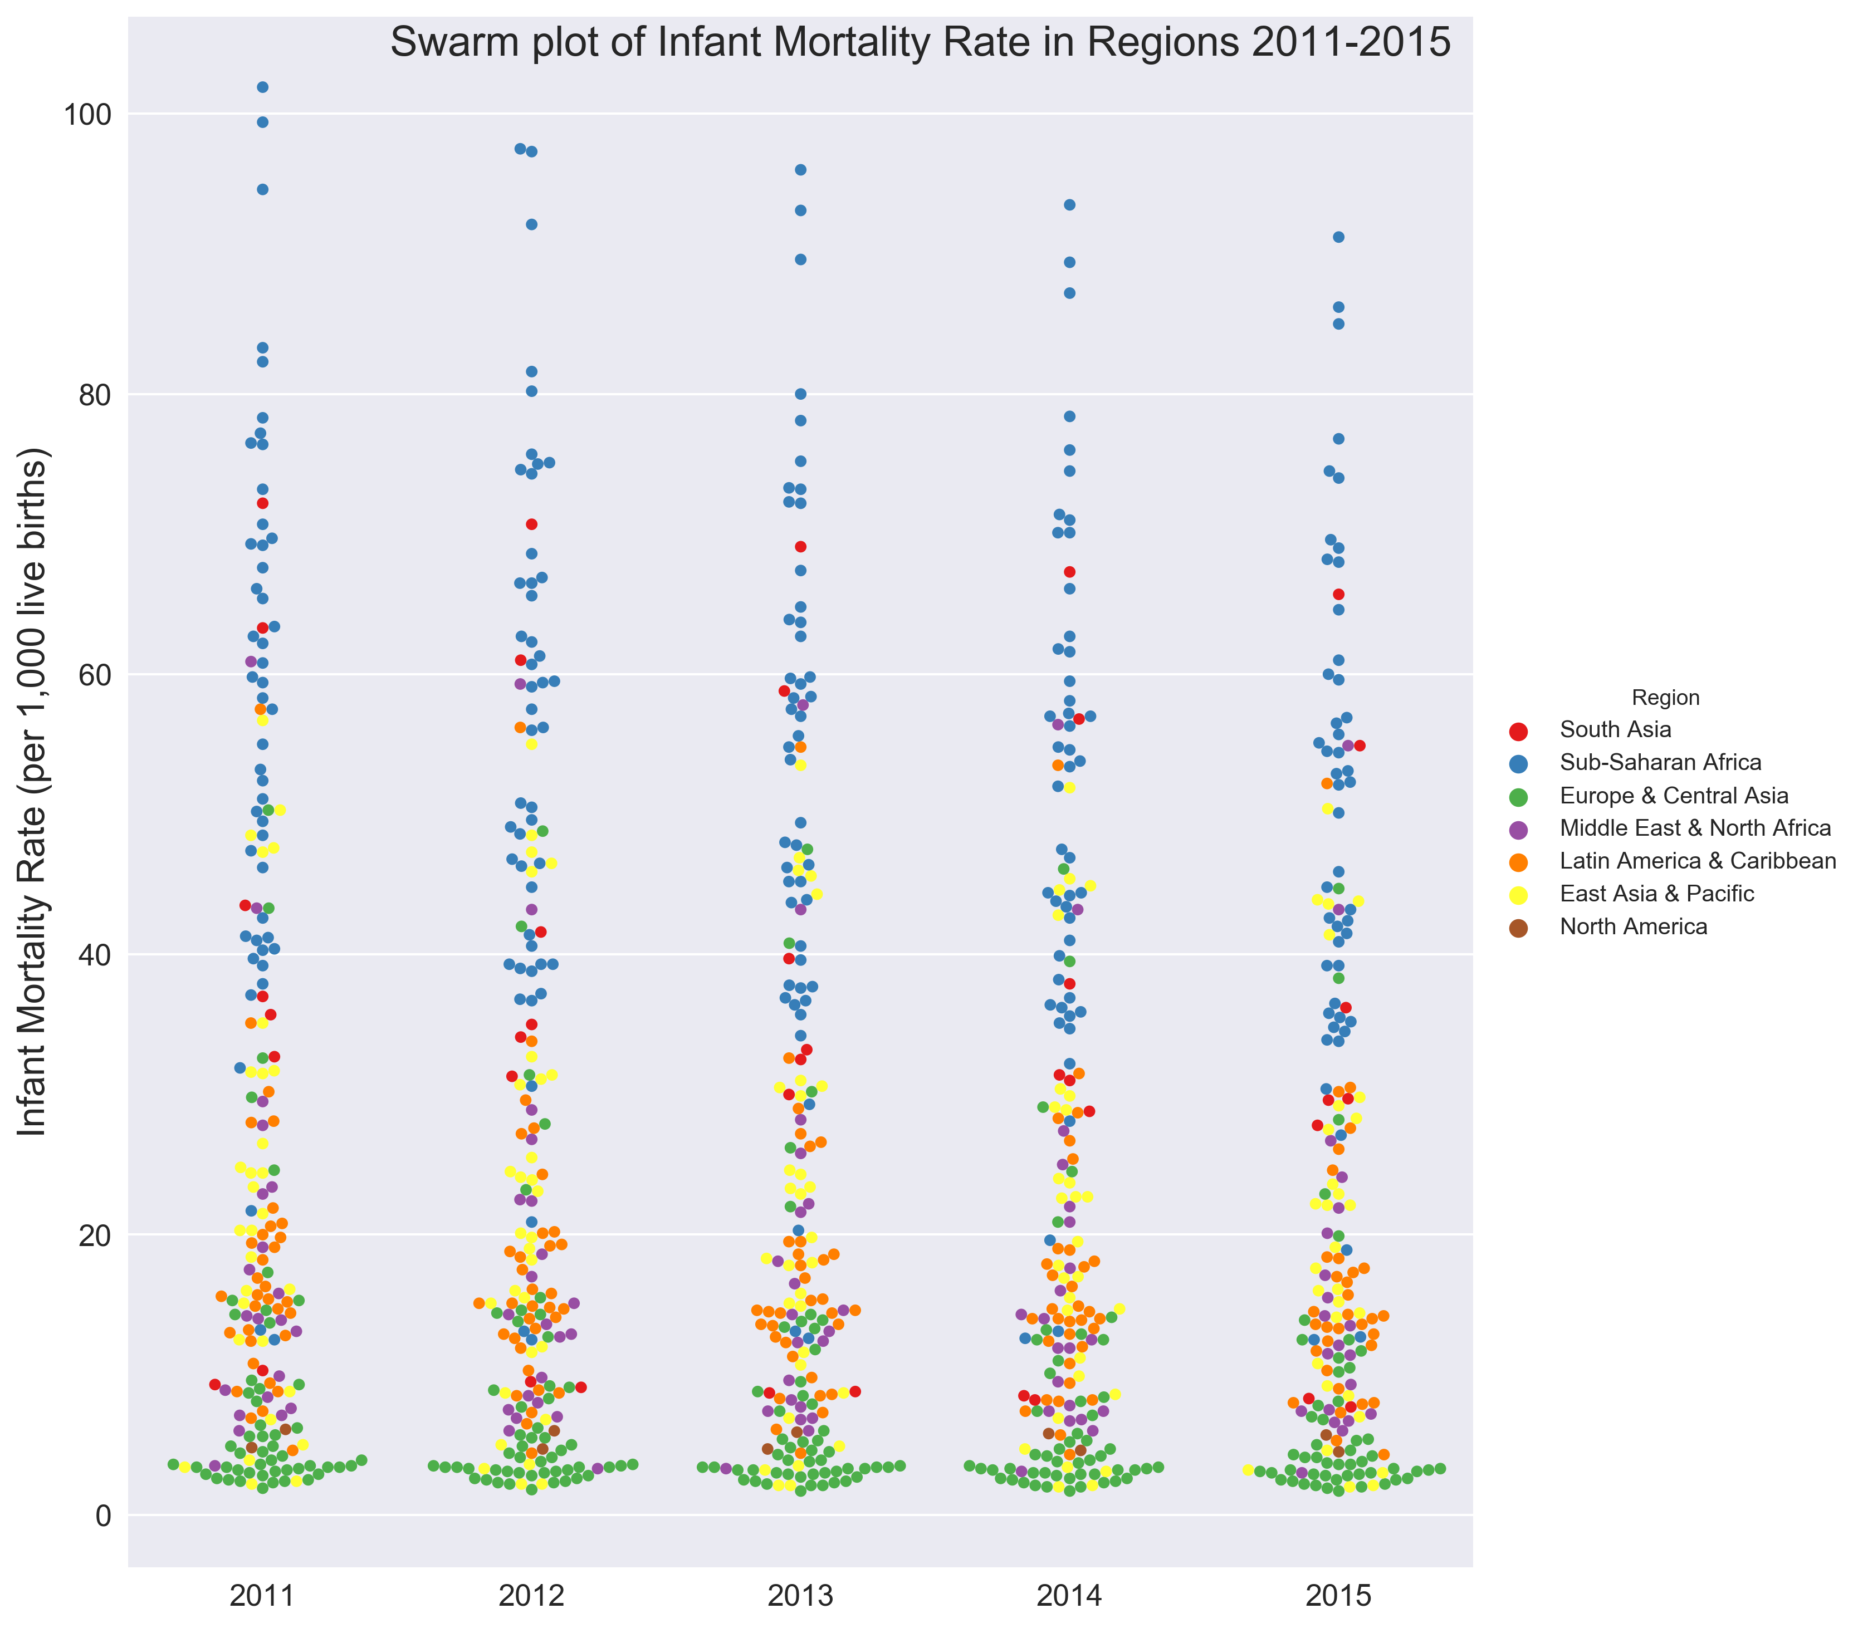

Slide 11
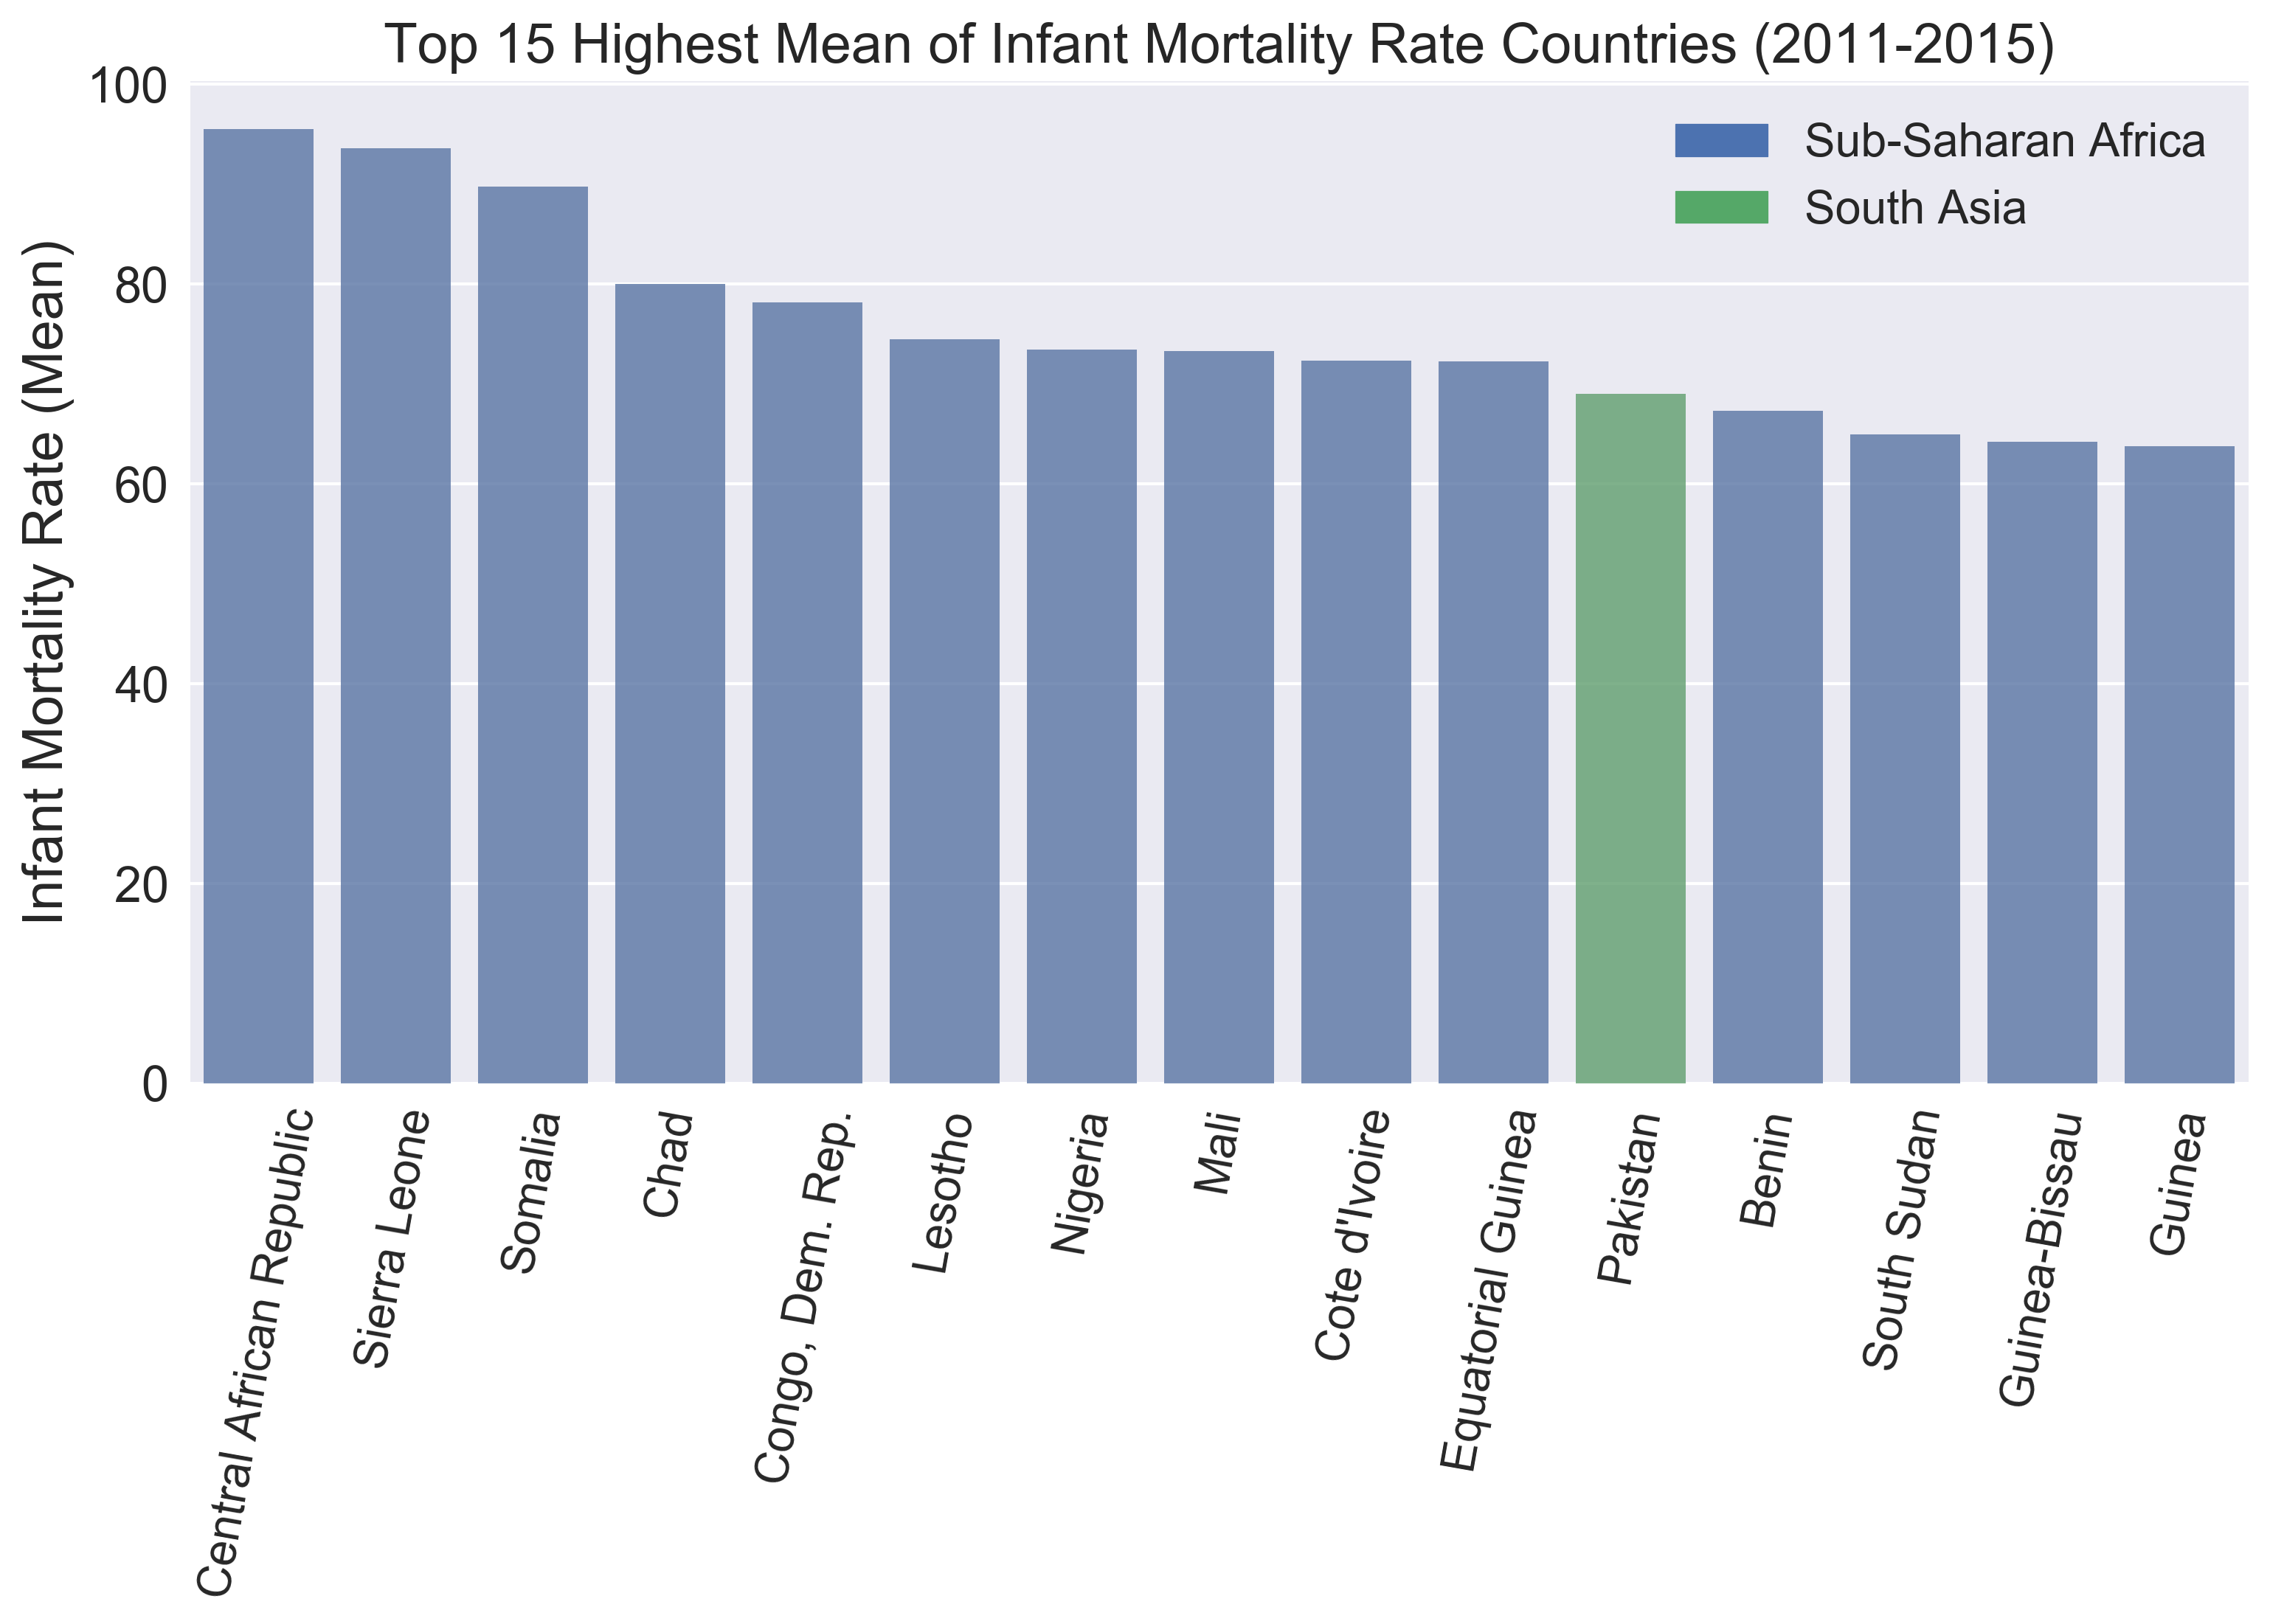
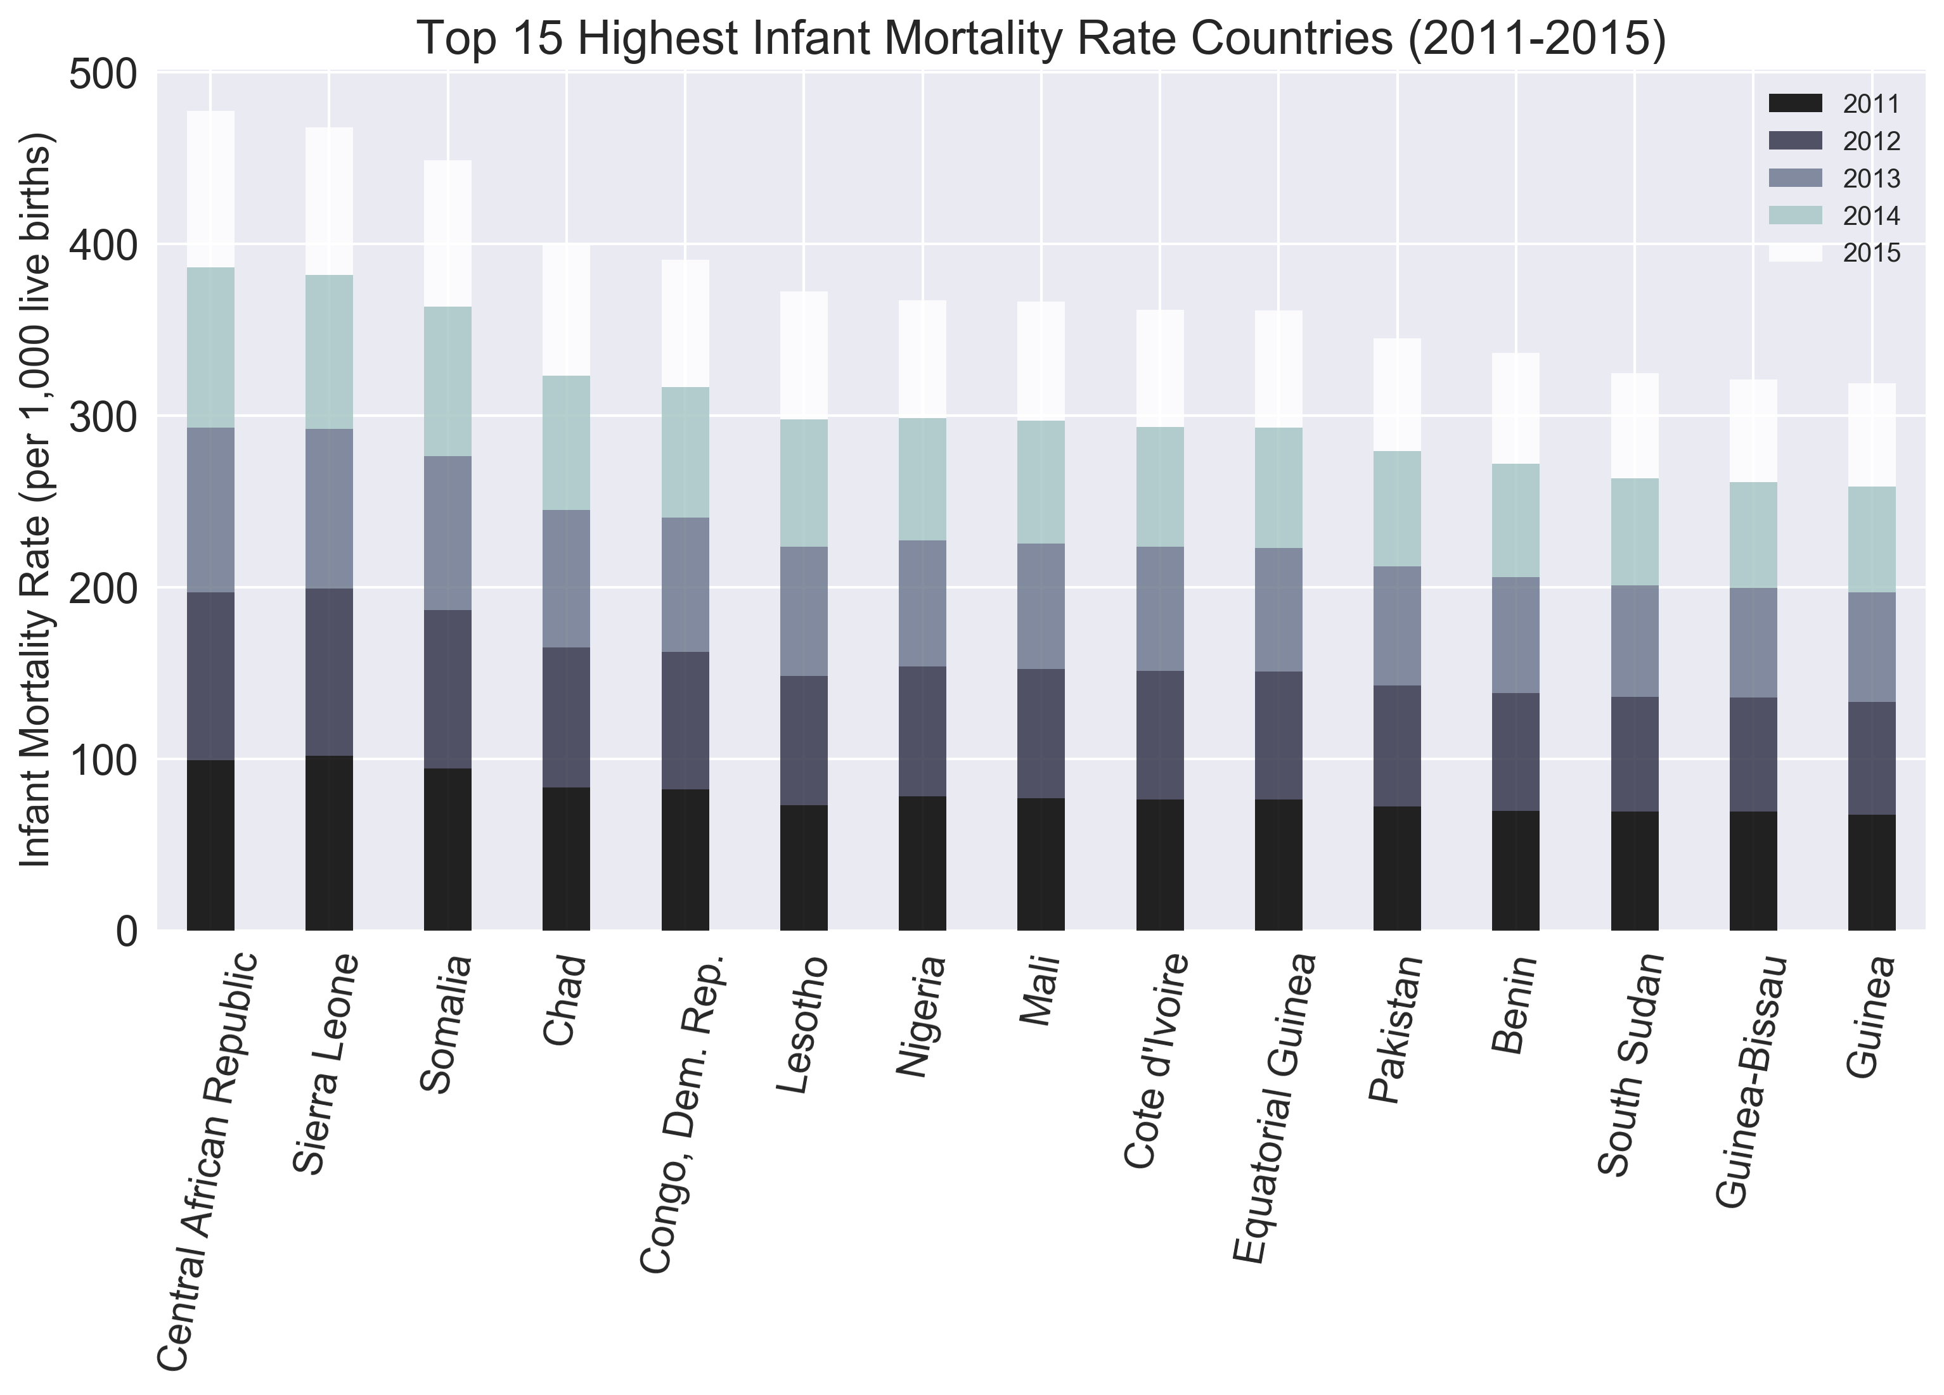
Over the Country: what country has the highest infant mortality rate?

Slide 12
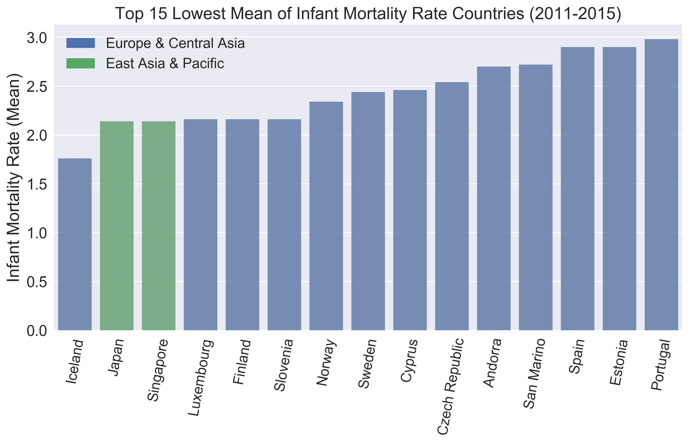
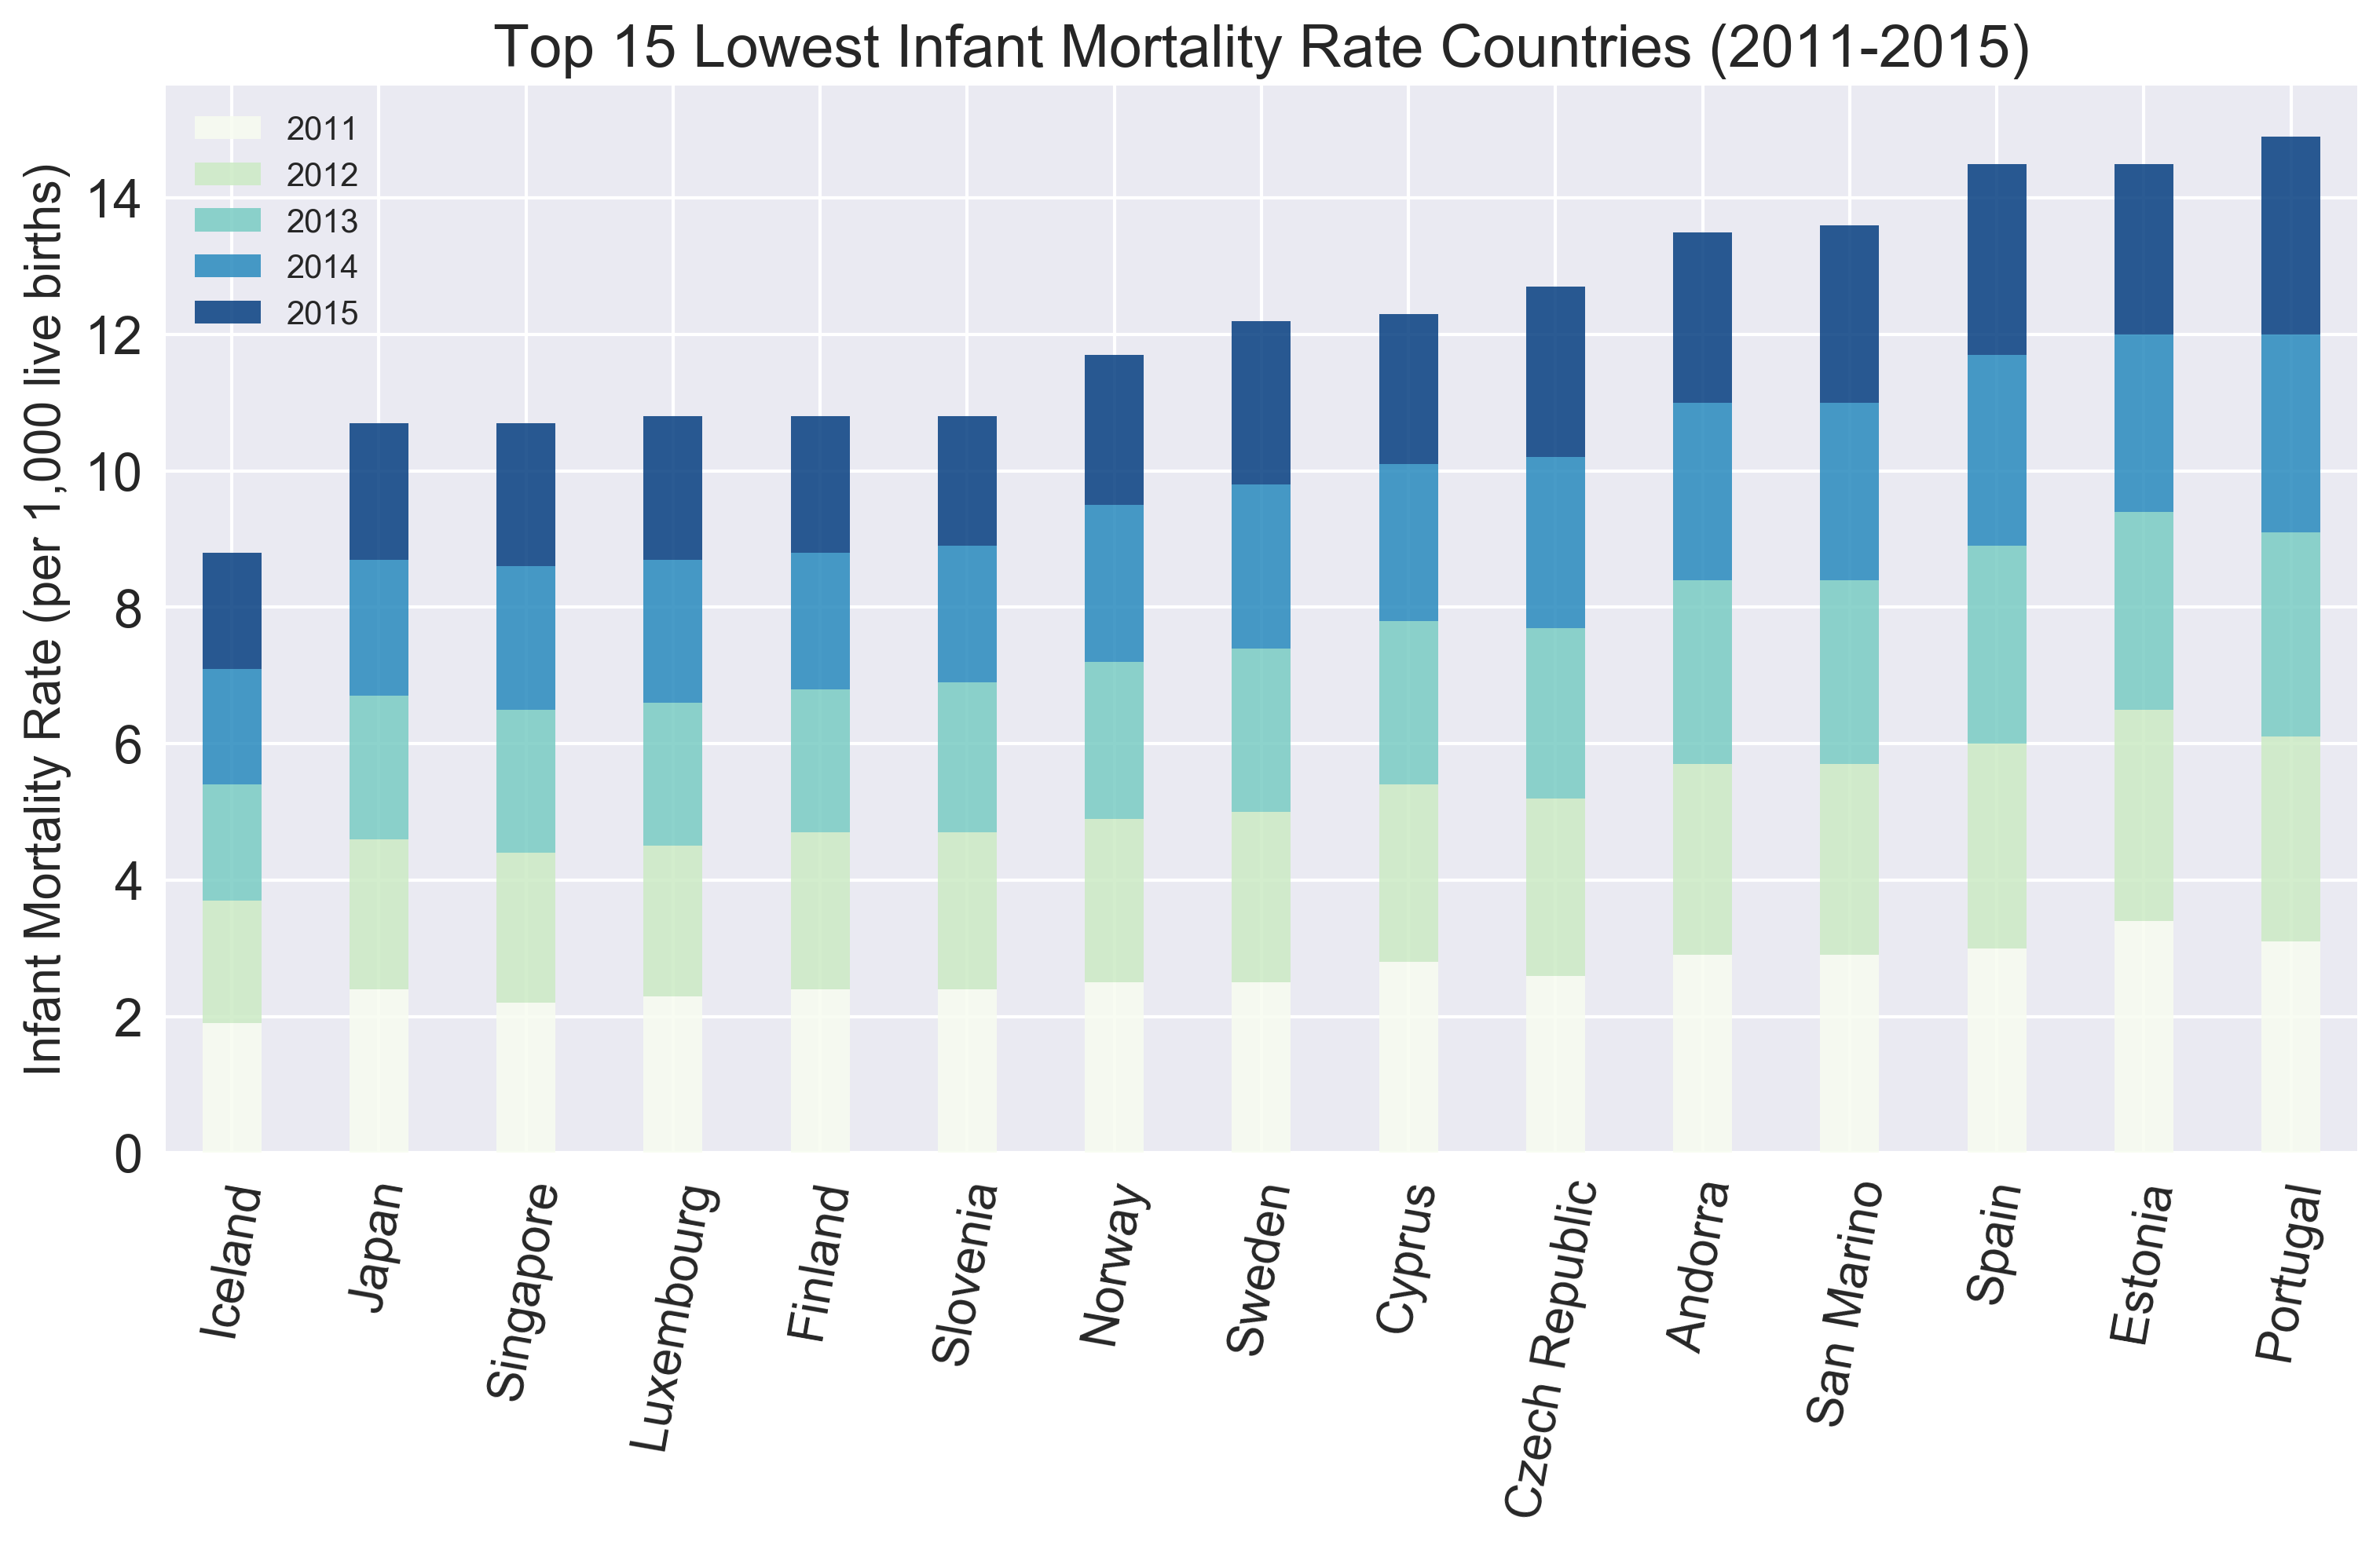
What country has the lowest infant mortality rate?

Slide 13
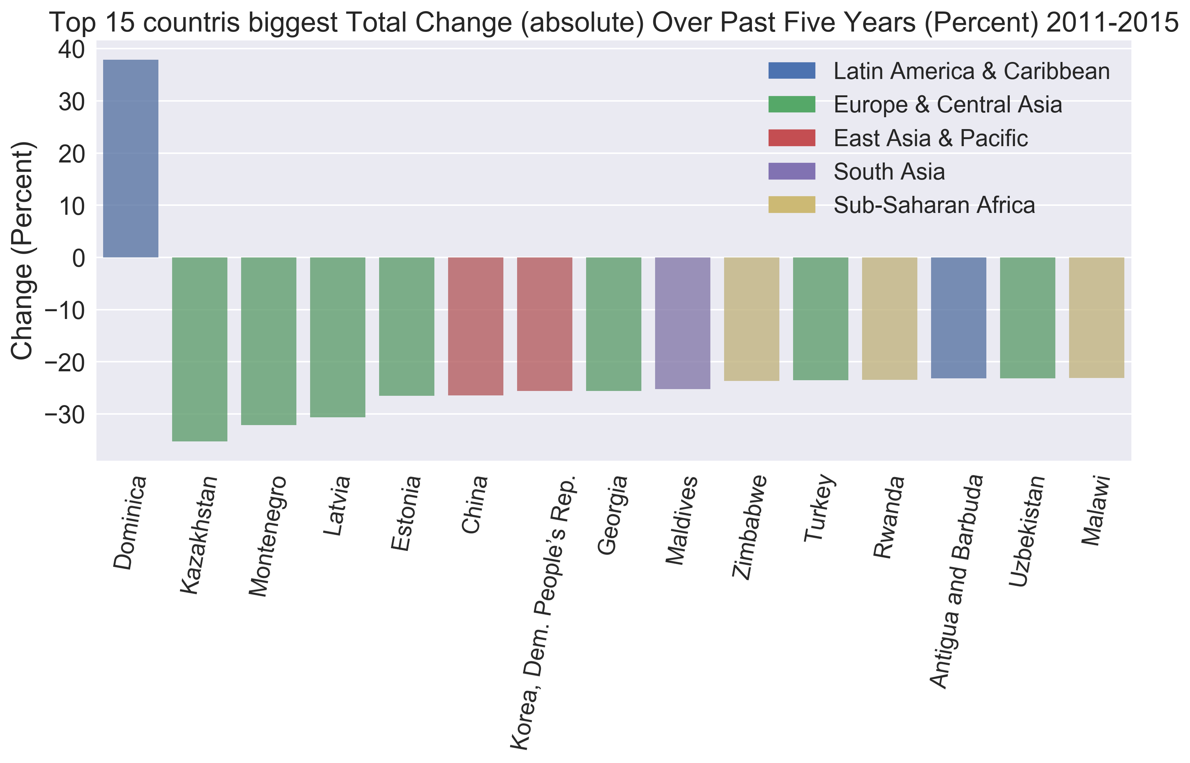
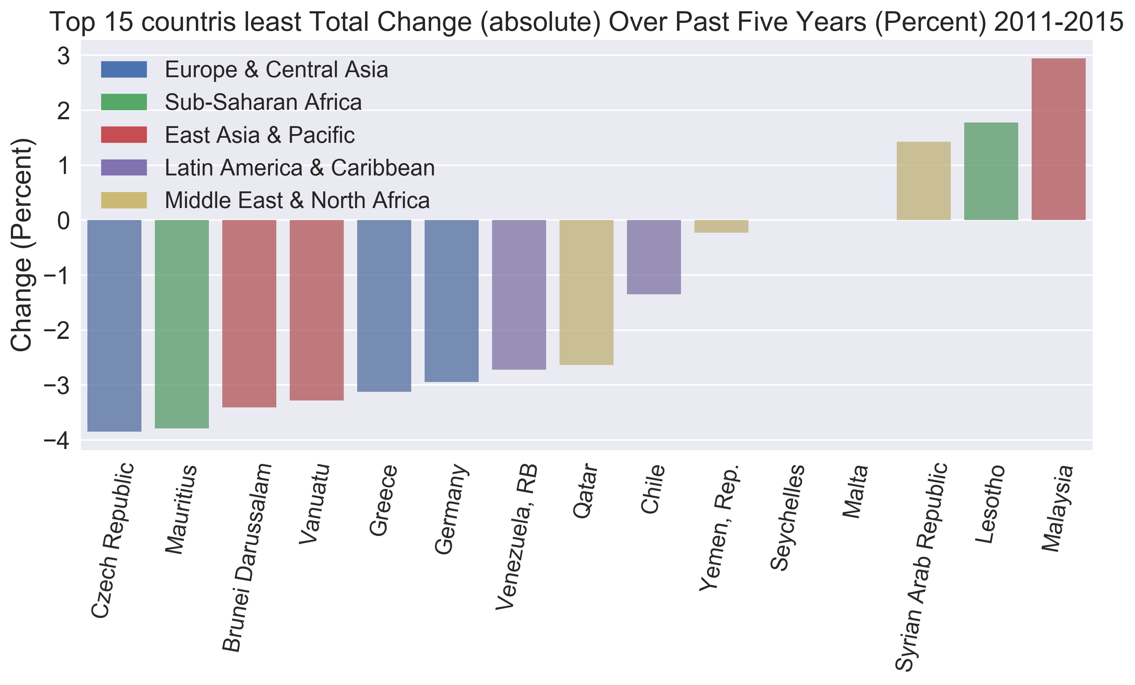
What about the absolute changes during 2011-2015?
Most volatile
Most stable

Slide 14
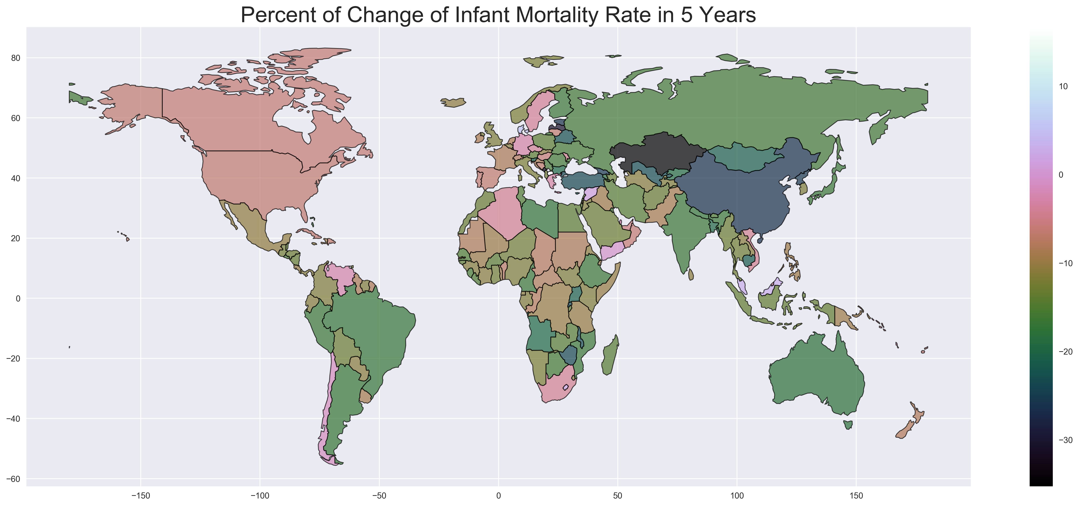
Notes:
The percentage of change

Slide 15
Overview in Fertility Rate
Region | Numb of Countries
East Asia & Pacific | 26
Europe & Central Asia | 48
Latin America & Caribbean | 31
Middle East & North Africa | 21
North America | 2
South Asia | 8
Sub-Saharan Africa | 48
Year: 2011-2015
Remove countries which have missing data in the period
Merged with infant mortality rate data frame

Slide 16
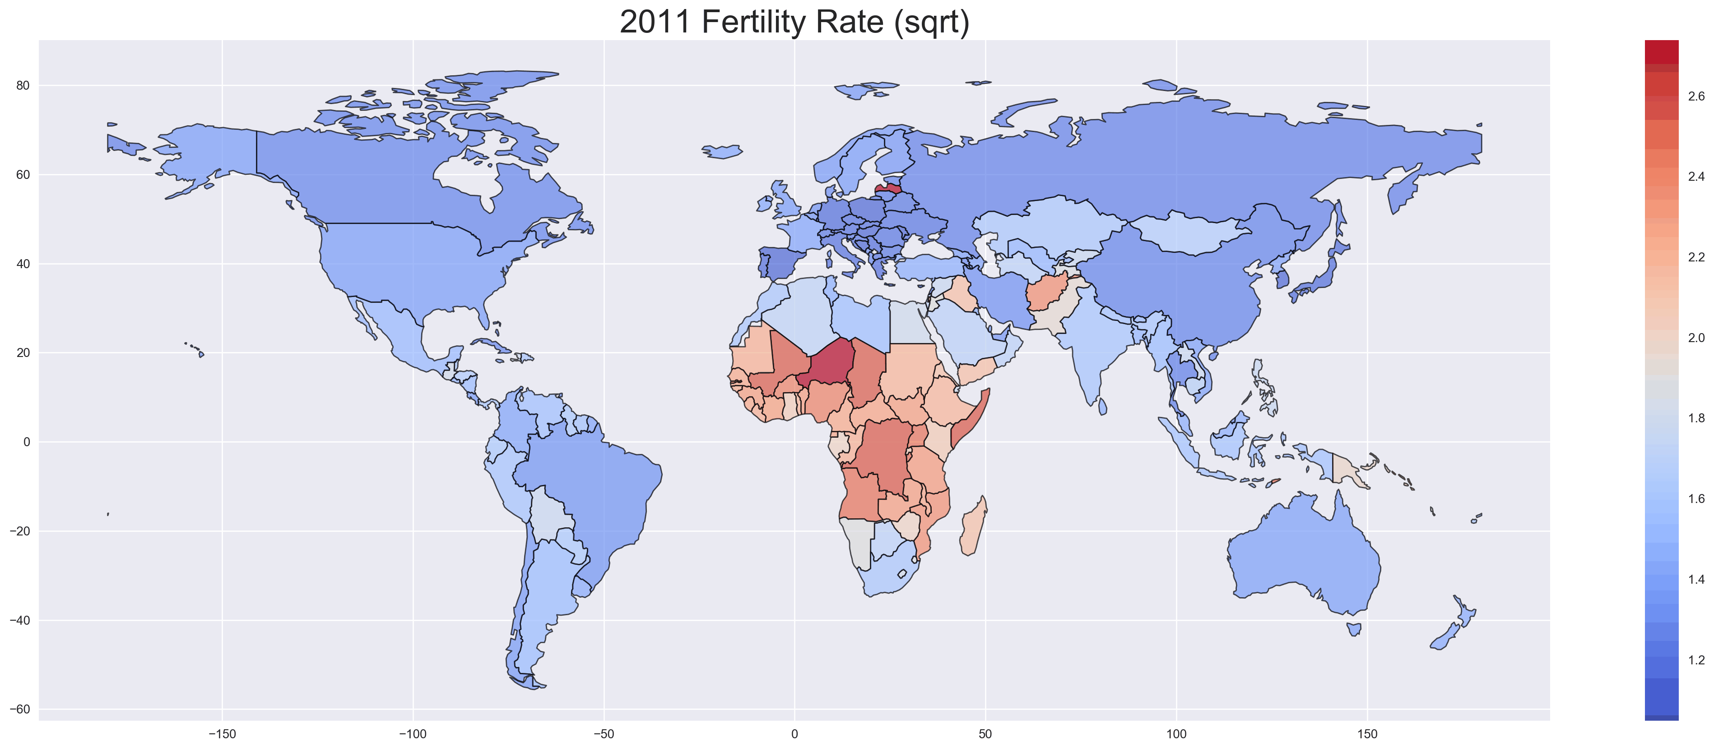

Slide 17
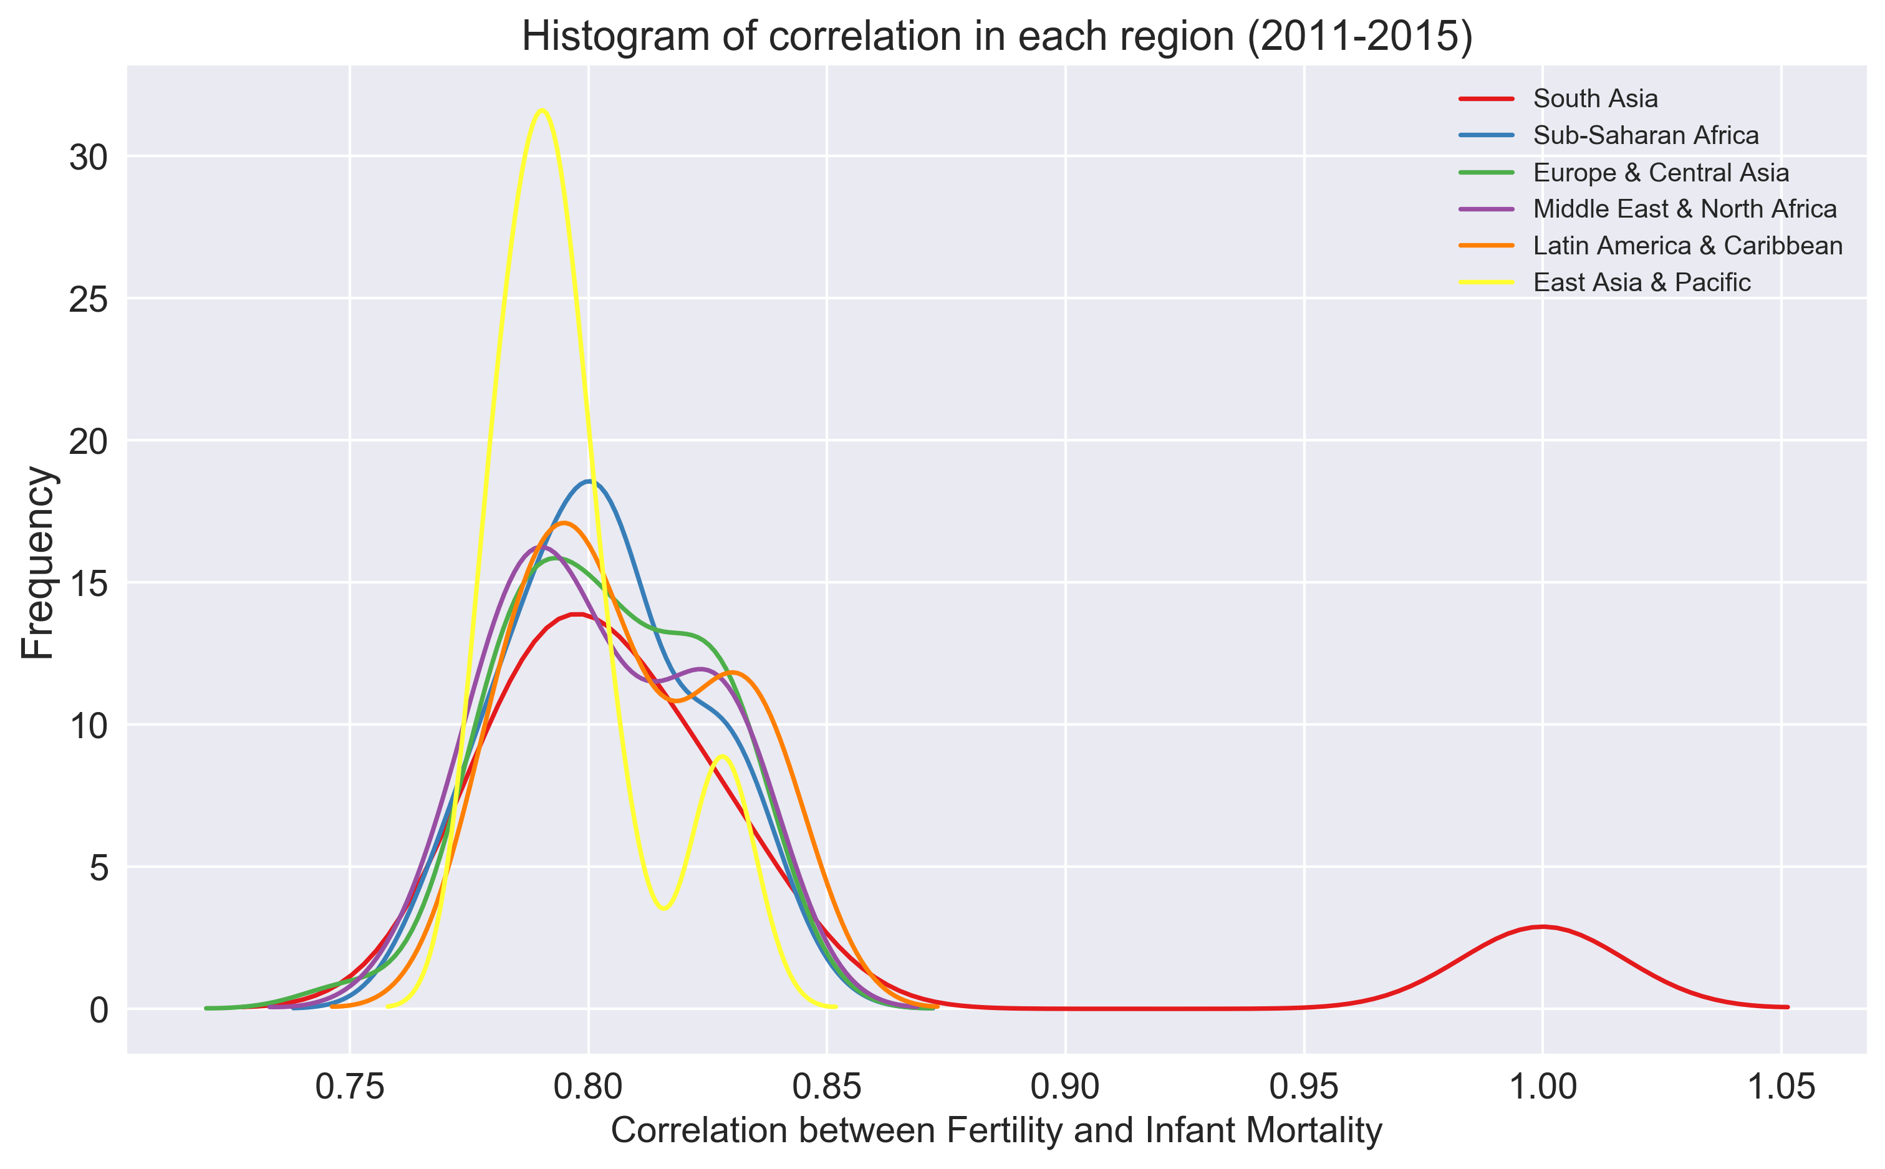
Correlation of Infant Mortality Rate and Fertility Rate
Year: 2011-2015
Merge infant data frame and fertility data as a new data frame Correlation
Remove countries which have missing data in the period 2011-2015
Compute the correlation in each country from 2011-2015

Slide 18
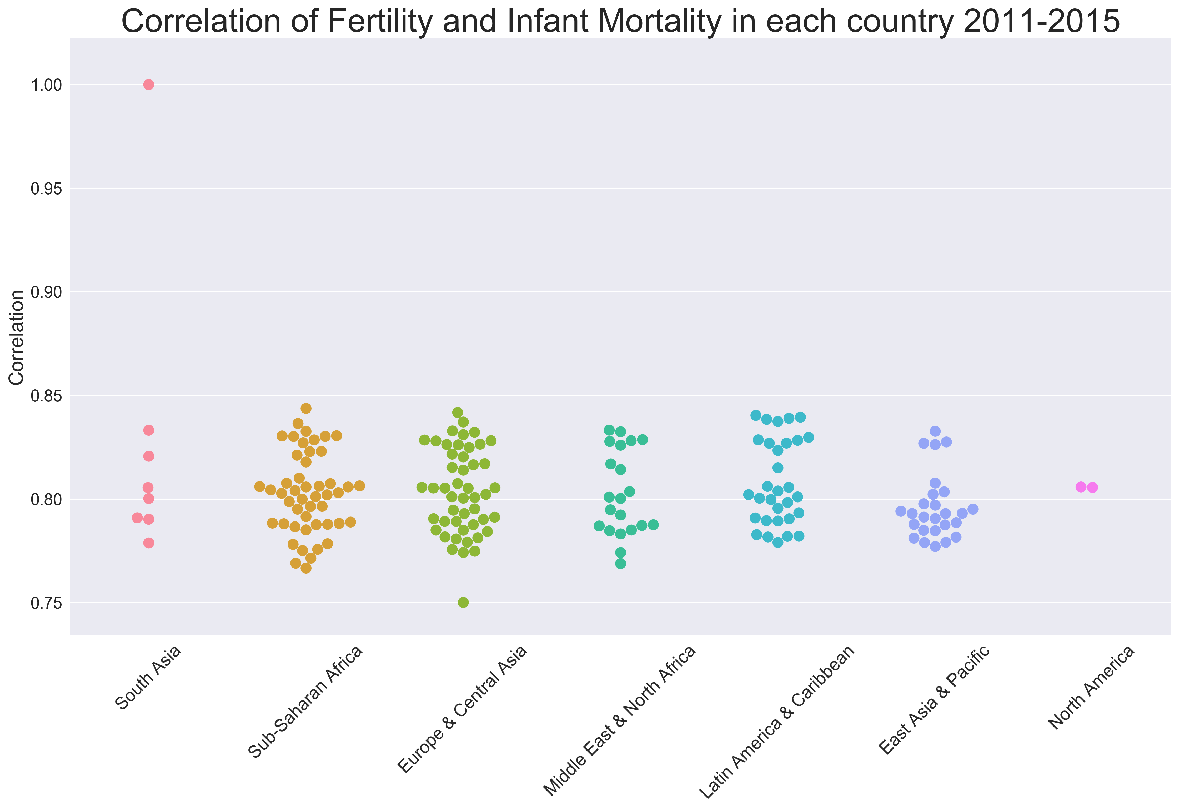
Correlation of Infant Mortality Rate and Fertility Rate
Year: 2011-2015
Merge infant data frame and fertility data as a new data frame Correlation
Remove countries which have missing data in the period 2011-2015
Compute the correlation in each country from 2011-2015

Slide 19
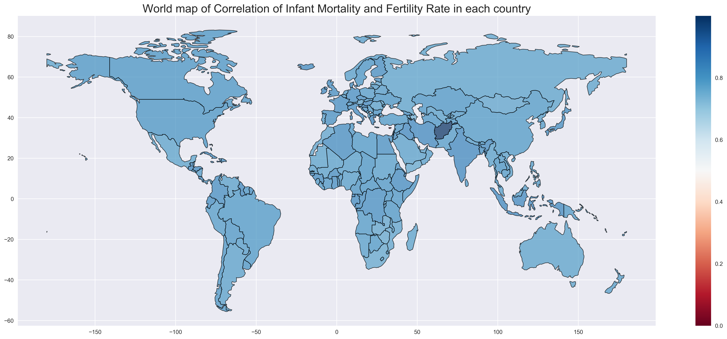

Slide 20
Conclusion
There is a strong positive correlation between infant mortality and fertility rate all over the world. Even we don’t know the causation, still the higher fertility rate strongly indicate higher infant mortality rate, vice versa.
In a social scientist view, we can say that infant mortality is connected with fertility in two ways. Reductions in child mortality is a key trigger for the fertility transition. It reduces the “demand” for children by improving the chances of survival to adulthood. On the other hand, as fertility rate goes down, parents will devote more time and resources to their children, which will increase the infant survival rate and thus decrease mortality rate.

Slide 21
What Will Happen Next
The world infant mortality rate will keep going down, but for some countries….
The world fertility rate will keep going down
In Sub-sahara Africa region, it’s still the highest mortality region in the world in the next 5 years
In Europ, it will keep stable as the smallest mortality rate in the next 5 years
In Japan, the infant mortality rate is decreasing indicate that the fertility rate is decreasing, thus the problem of aging population is getting worse

Slide 22
Code Walk Through

Slide 23

My email: mandy_zhang512@gwu.edu

